Slide 1

Building SPAs the “right” way
Making apps maintainable, fun, and fast.
Notes:
Hello, welcome to Building SPAs the “right” way. My name, is Justin Meyer, I’m CEO of Bitovi, and
bin/import
localStorage.clear()
get from chicago

Slide 2
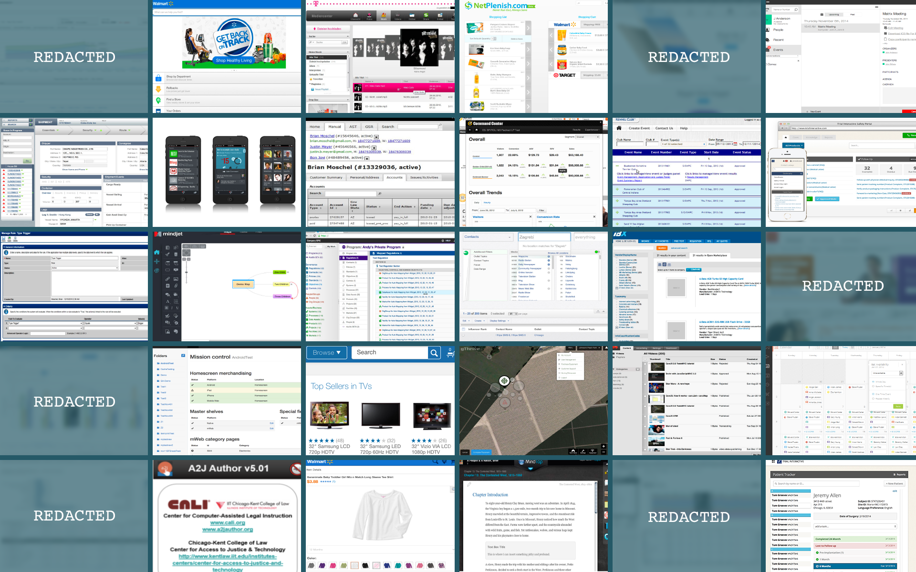
Notes:
In the last 7 years, I’ve either worked on directly or overseen 30 different JavaScript projects for about 7 companies:
- big companies and small companies
- teams of 2 and teams of 30
- for apps that target IE6 to mobile, phonegap and node webkit
- I’ve even used other open source projects

Slide 3
Outline
Checklists
Modlets
Semver Packages
Custom HTML Composition
Unit Testable ViewModels
Two Way routing
SuperModels
Live Reload
Smart Progressive Loading
Server Side Rendering
Notes:
This talk is a collection of the best or unique or sometimes both techniques we’ve used to make maintainble, fun, and fast single page applications.
I’ve structured this talk into 10, 5 minute lightning talks. So on speaker rate, you can rate me 10 different times.
In each one
where I’ll cover a technique we use, why we use it, and an example of it in action, showing off any “cool” tech we use to do it.
This talk is going to go very fast and be very technical. Some of the code examples might be hard to follow. However, hopefully I’ll be able
to clearly explain the general technique and the benefits from it.
To demonstrate
Unfortunately, I am not able to show any of our clients code

Slide 4
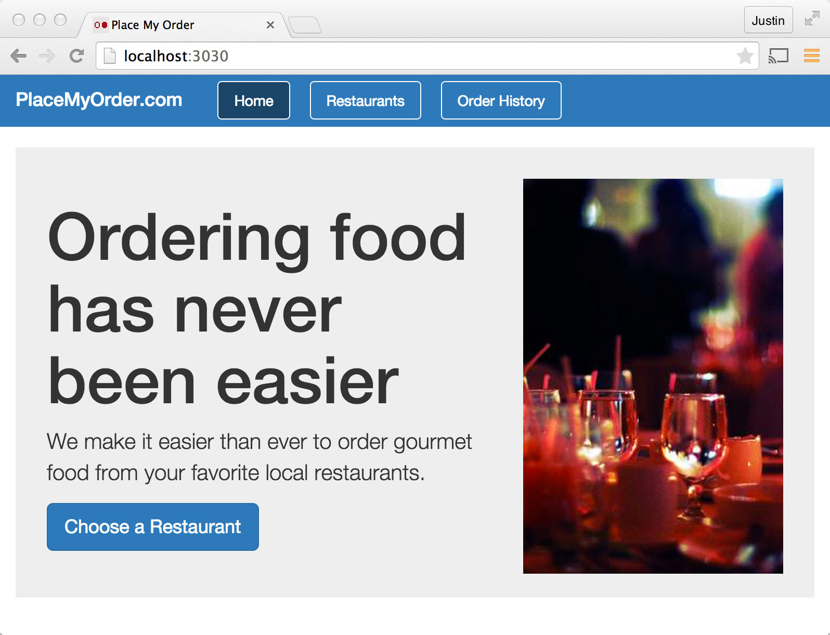
place-my-order
github.com/
bitovi/
place-my-order
Notes:
- on github
A simple app, that has a lot of complex improvements … real time, server side rendered, and is built with the techniques in mind.

Slide 5
Outline
Checklists
Modlets
Semver Packages
Custom HTML Composition
Unit Testable ViewModels
Two Way routing
SuperModels
Live Reload
Progressive Loading
Server Side Rendering

Slide 6
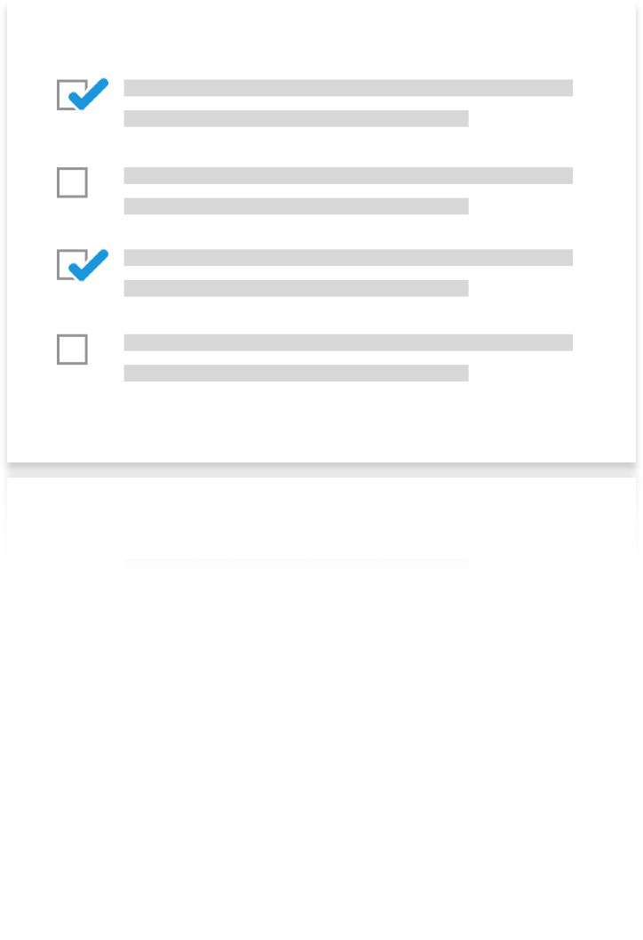
1. Checklists
A JavaScript
Project
Checklist
http://bitovi.github.io/checklist/
https://github.com/bitovi/checklist
Notes:
Best and most unique
Make everything better
Humans with checklists
Software development is no exception.
We all know the right things.
Our checklist has management, user exp, and dev questions

Slide 7
Management
Release < 6 months 0.48
Yearly Trainings 0.46
Vision, Goals, Strategy, Roadmap 0.45
Social Events 0.45
Notes:
Great management, it seems, makes sure people know what they are trying to do, makes sure they are able to do it, and make sure they enjoy what they are doing.
A clearly defined Vision / Goals / Strategy / Roadmap helps developers know what they are working on, and likely has all sorts of communication and decision making advantageous.
A company providing its employees at minimum yearly trainings was the most influential factor we found.
Finally, companies that have social events also proved pretty impactful.
I don’t think we should discount the social aspect of humans, even developers with our eccentricities.
Having people get along makes a lot of sense. We’ve had projects where people fought a lot. And others that made
harlem shake videos.

Slide 8
Design
User testing 0.45
Design documentation 0.44
Notes:
In the end, we found that design and management related things had a the most significant design-related impact on project success.
This makes sense because design teams that talk to actual users are going to make better design choices, and design teams that produce good documentation for managers to debate and developers to build are likely to streamline development significantly.

Slide 9
Development
Is every module Code Reviewed? 0.28
Is every module Documented? 0.28
Is every module Tested? 0.20
Notes:
For development, code reviews, documentation, and testing were the most influential.

Slide 10
A JavaScript
Project
Checklist
http://bitovi.github.io/checklist/
https://github.com/bitovi/checklist
Notes:
Let's people know they are not the center of the universe.

Slide 11
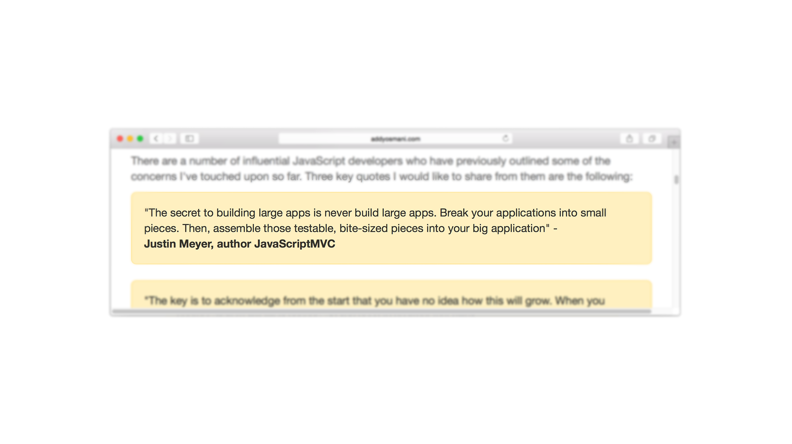
2. Modlet Workflows
Source: http://addyosmani.com/largescalejavascript/
Notes:
Number 2! Modlet workflows!
I found this quote on Chrome team developer Addy Osmani’s site:
The secret to building large applications is to never build large applications. Break your applications
into small pieces. Then, assemble those testable, bite-sized pieces into your big application.
One of our earliest, and most important development strategies was the introduction of the modlet workflow. It’s a very simple concept – every module should
be developed as its own application.

Slide 12


FOLDERS
project/
js/
moduleA.js
moduleB.js
templates/
moduleA.handlebars
moduleB.handlebars
css/
moduleA.css
moduleB.less
test/
moduleA_test.js
moduleB_test.js
docs/
moduleA.markdown
moduleB.markdown
Notes:
In practice, this means that instead of a folder structure like this, where files are grouped by type,

Slide 13
FOLDERS
<-- MODLETS!
project/
moduleA/
moduleA.js
moduleA.handlebars
moduleA.css
moduleA_test.js
moduleA.markdown
test.html
moduleA.html
moduleB/
Notes:
We put every module in its own folder, including its tests, documentation, and other supporting files like styles and templates.
Additionally, we add:
A demo page (moduleA.html) that shows off the modules functionality if the module has a visual representation.
A test page (test.html) that runs just the module’s tests.
we call this structure a modlet. Like applet, but for modules
----- Meeting Notes (5/10/15 20:11) -----
animation borked

Slide 14
Benefits
Easier to identify missing tests or documentation.
More likely to update tests and documentation.
Good API design.
Easier to develop in isolation.
Notes:
proximity

Slide 15
Example
http://localhost:3030/app/order/demo.html
http://localhost:3030/app/order/test.html

Slide 16
3. Semver Packages
Put modules in their own repository
Publish them to NPM (or bower)
Import and use in the main app
Notes:
The next topic is how we have been pulling parts of the application and putting them in their own repositories, publishing them to npm (or to bower), and then
importing and assembling them into our main application.
This is the “extremist” form of “build every module as its own application” that I’m aware of, but the technique or putting parts of the app in different repositories
is not new.
What I think is special about the way we do it, is:
how easily and comprehensively we can do it, especially considering the fragmentation of module loading in client side JavaScript. CJS + AMD + ES6 syntax
I think we’ve solved enough problems to make multiple repository workflows practical.
use semantically versioned packages published to npm or bower to break up our app.
Lately, Bitovi has been taking the "build every module as its own application" to the extreme by putting many of our modules in their own repositories, publishing them to NPM, and importing them into our final application.
For example,
This article talks about:
* What this looks like
* Why you should do this
* why it wasn't easy previously
* how to do it
## What this looks like
The `place-my-order` app needs a tabs widget. Instead of creating a tabs widget ourselves, we created [bit-tabs][1]. `bit-tabs` is a tabs widget that has its own tests, docs, and styles. It's written in ES6 syntax and uses ES syntax to load its modules, making it accessible to only the most modern module loaders.
However, its [Gruntfile.js][2] is able to export its source to CommonJS, AMD, and standalone so it can be used on any project.
In `place-my-order`, we install this into the project with:
npm install bit-tabs --save
And can immediately import it into our project.
## Why
Creating and maintaining another repository takes a bit more time and effort then doing everything in the main repository. You have to create the repository, setup a build, setup CI, and publish your code. Why go through this extra effort?
* Reuse - In big organizations, you don't want to write the same code over and over. This makes your code available to everyone. I can't tell you how many times this one company recreated the same calendaring logic for its strange quarters and weeks that didn't start on Sundays.
* Fine grained control - Imagine you have 3 teams developing three different pages. Even with the best branch and merge strategies, it can be complex to merge these all into a release branch, especially if one of the pages has an error that is discovered late. With packages, it's easy to roll back just the offending page to an earlier version.
* Thinking Semver - A semantic version number is an incredibly useful bit of meta information. It expresses if a module had a bug fixed, features added, or broke its API. This information is never articulated if the module is developed within a larger app. This makes it difficult for the consumers of that module to know that changes happened or the types of changes.
[1]: https://github.com/bitovi-components/bit-tabs
[2]: https://github.com/bitovi-components/bit-tabs/blob/master/Gruntfile.js#L27

Slide 17
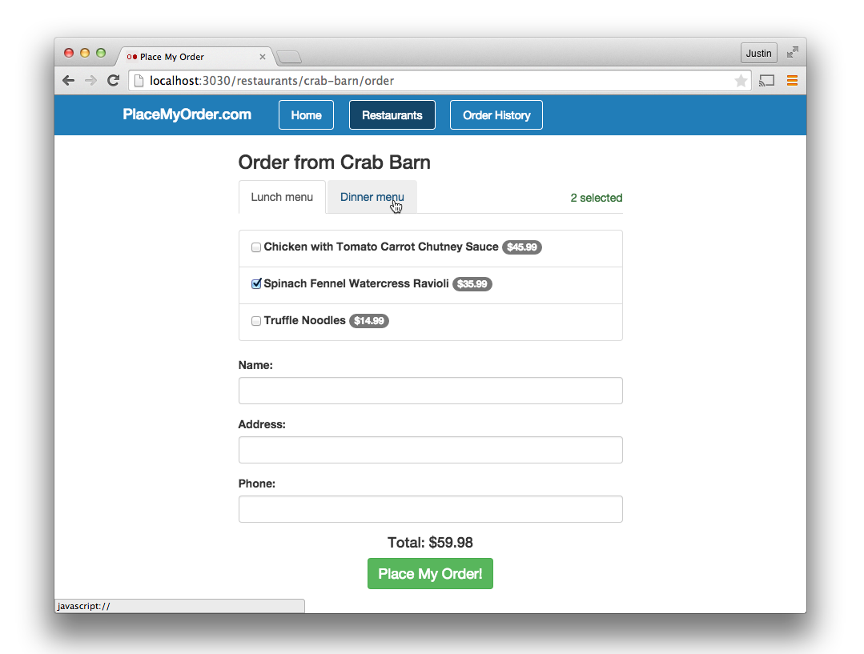
Notes:
For example, this tabs widget, instead of locking it away inside the place-my-order application, we created it in its own repository – bit-tabs.

Slide 18
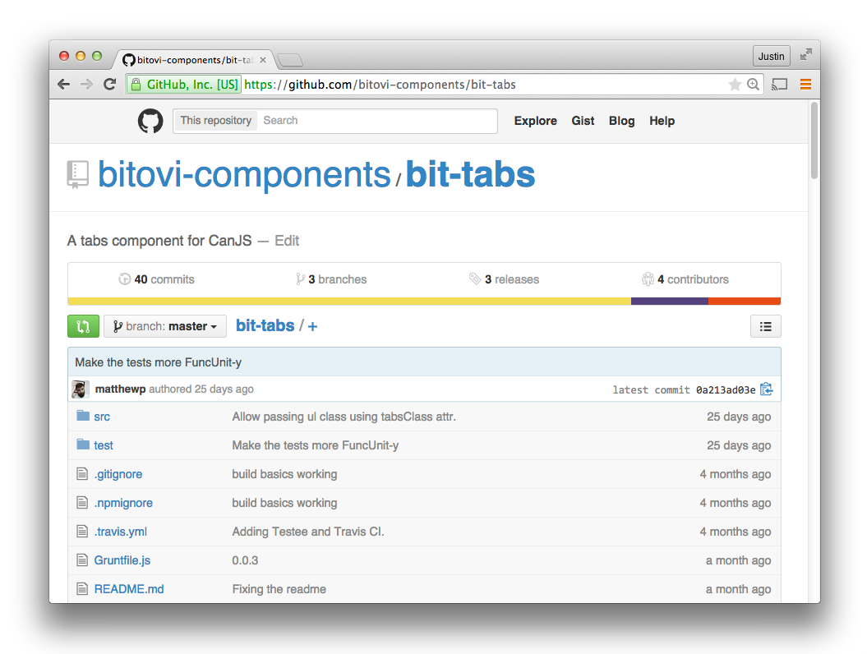
Notes:
These repos will have their own tests and docs. But now, thanks to NPM (and to some extent, bower) for finally giving us a package management tool
for JavaScript,
To use it in an app, all I need to do is:
npm install bit-tabs --save
And import it
npm install bit-tabs
And even though bit-tabs is written in ES6 and imports a less file, and a template, we are able to export it so it can be used
with Browserify/CommonJS, RequireJS/AMD, and a standalone download.
This has been great for big organizations where
Whole pages

Slide 19
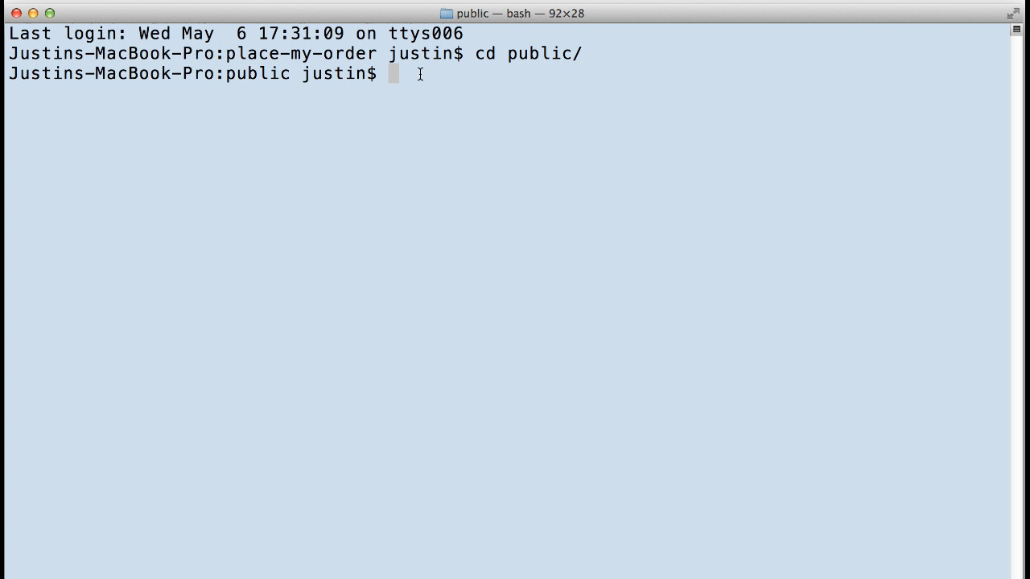
Notes:
Thanks NPM
install it with NPM
npm install bit-tabs --save

Slide 20
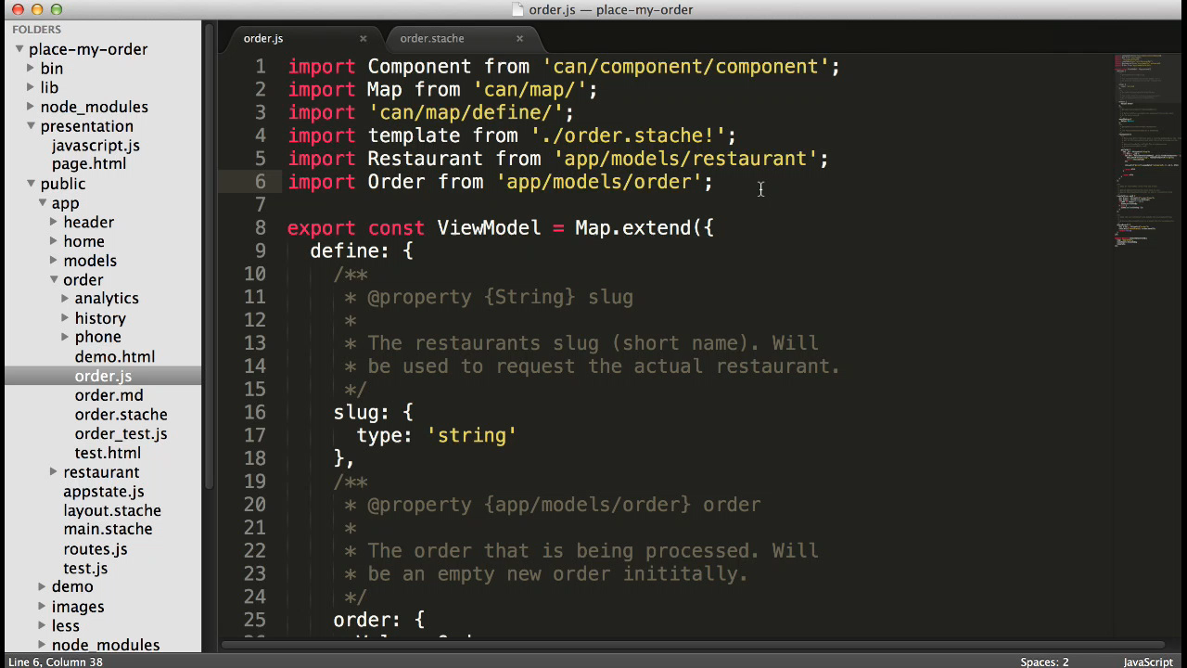
Notes:
Import it and use it in your project.
Yes, we are using Traceur to transpile our project so we can use the ES6 syntax.
So, hopefully you can see how one half of this, importing packages into your project is easy. If you are using CJS + Browserify, you
have probably seen a lot of this.
However, if you are using CJS and browserify, you are ignoring all the other dependency management solutions.

Slide 21
Dependency Management Options
import bitTabs from 'bit-tabs';
// CommonJS / Browserify
var bitTabs = require('bit-tabs');
// AMD / r.js
define(['bit-tabs'], function(bitTabs){});
<!-- Script and Link tags -->
<script src='bit-tabs.js'></script>
<link href='bit-tabs.css' rel='stylesheet'>
Notes:
The problem with client-side development is that everyone has their own way of importing scripts. Even within a single organization, you might have some people using
CommonJS and browserify, others using RequireJS and r.js, and others still using <script> tags.
But, you don’t want to rewrite

Slide 22
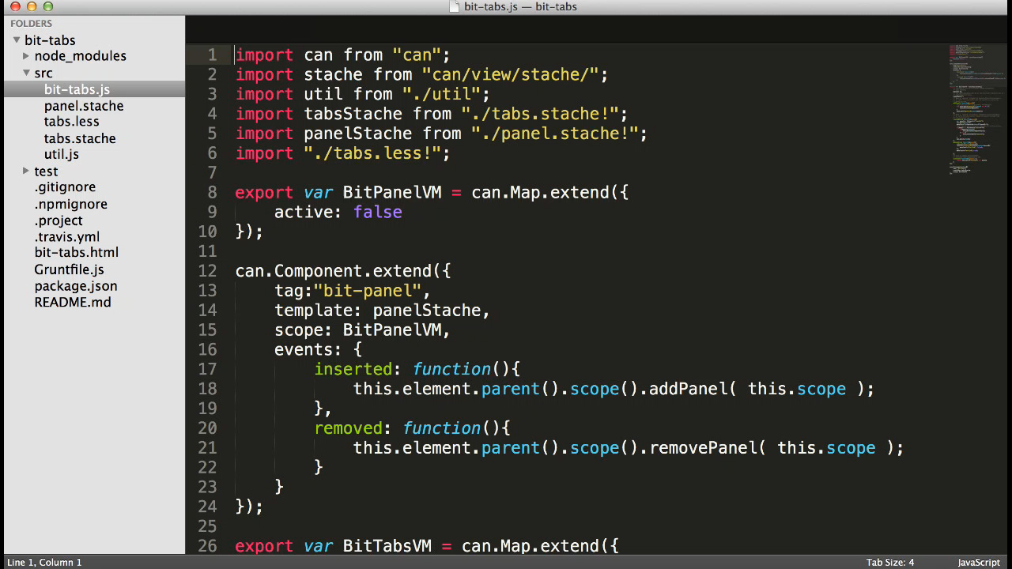
Notes:
This is why, for projects like bit-tabs, which has its own less/style files and templates, we use StealJS to export the project into all of these formats.
You can see

Slide 23
Semver Packages Benefits
Reuse
Thinking Semver
Easier Release Management
Client Side Open Source
Notes:
Reuse - In big organizations, you don't want to write the same code over and over. This makes your code available to everyone. I can't tell you how many times this one company recreated the same calendaring logic for its strange quarters and weeks that didn't start on Sundays.
* Thinking Semver - A semantic version number is an incredibly useful bit of meta information. It expresses if a module has a breaking change, a new feature, or a bug fix.
* Fine grained control - Imagine you have 3 teams developing three different pages. Even with the best branch and merge strategies, it can be complex to merge these all into a release branch, especially if one of the pages has an error that is discovered late. With packages, it's easy to roll back just the offending page to an earlier version.

Slide 24
4. Custom HTML Composition
It’s awesome!
Composable Elements
Template Dependencies
Composing Custom HTML Elements
Notes:
Outline
- Custom HTML has taken over JavaScript development.
instead of having something in your page, and calling $().datepicker(), you just put in a datepicker.
Most people have solidified around HTML orchestration, and I think for good reason:
it’s a language that most people are pretty familiar with
it can easily show hierarchy, its nested
We are producing HTML
- Compositing Elements
- Template dependencies
- Composing components
Number 4 is “Advanced HTML Template Orchestration”. By now, hopefully most people are aware of how HTML or a combination of HTML and some templating language have taken over the
responsibility of assembling the parts of an application into its final form.
Previously, we would wire up jQuery or Backbone widgets like this:
jQuery UI example
Now, using custom elements or directives, we use something like HTML to assembling the pieces of an application. It might look like this:
in anguar
in react
in polymer
in CanJS
So, how do we approach orchestration? We always right the most beautiful template possible. Try to write logic that is clear and understandable, that a designer could
understand. If you are doing this, you probably
It seems everyone has solidified around HTML orchestration, and I think for good reason:
it’s a language that most people are pretty familiar with
it can easily show hierarchy, its nested
We are producing HTML
So, we’ve also fallen in love with this and added two enhancements that I think are pretty cool:
1.
Write nice templates first. This is like building a “demo” for your app. How everything should piece together.
Load dependencies.
Write cool
We, like many other people, have fallen in love with poweful templates.
import the modules
assemble them together
We take our time authoring them … making them easy to see and understand. maintainability angle.
In comparison to old new Widget or $().widget();
1. write them in such a way that someone can understand them.
2. show high-level assembly
3. load dependencies.
We’ve added a few cool things to our templates.
more than live binding
wire up and connect
elegant
the assembly layer
So now lets talk about how we actually build applications. I approach application development simultaneously from the top down and the bottom up.
From the TOP, I try to create a “perfect” HTML orchestration layer. Something pretty enough that a designer will understand it. Implementing
this
From the BOTTOM, I write view model tests that encapsulate the behavior of some small part of the ViewModel.

Slide 25
page.html
<html>
<body>
<input id='datepicker'/>
<script src='jquery.js'></script>
<script src='myapp.js'></script>
</body>
</html>
Notes:
Many of you in this room might be old enough to remember, before 3 years ago, where to
add functionality to your site, you had to create some HTML, and then somewhere else initialize that HTML with

Slide 26
myapp.js
$("#datepicker").datepicker();
Notes:
Now, that’s all changed. Almost every modern framework lets you add a custom element either directly to the page or within a template.

Slide 27
react.jsx
render: function() {
return <div>
<DatePicker value="date" />
</div>;
}
Notes:
React lets you write custom elements in JSX

Slide 28
react.jsx
angular.html
<datepicker ng-model="date"/>
Notes:
Angular lets you write them directly in the page

Slide 29
react.jsx
angular.html
canjs.stache
<datepicker value=“{date}"/>
Notes:
And CanJS lets you write them in a customized version of handlebars.
So when we write a template for an application, and the custom elements that power it, we have two somewhat conflicting goals:
1. Make our templates clean enough so this guy can understand them.

Slide 30

Notes:
This is Bitovi’s UX director. He doesn’t know how to write much JavaScript, but he knows HTML and CSS.
Our second goal is to make them flexible enough so he can make new behaviors and functionality without bothering us.
I think we do two interesting things to help with that.

Slide 31
“Tag team”
elements that load data.
composable widget elements.
<order-model find-all="{status=‘new’}”/>
<bit-graph title=”New Vs Old">
<bit-series data="{newData}" />
<bit-series data="{oldData}" />
</bit-graph>
Notes:
The first is the combination or “tag team” of
- custom elements that can load data – order-model here will request all orders that are due today and make them available in the template.
- and compose-able widget type elements that change their behavior when elements get added or removed.
Lets see a brief example.

Slide 32
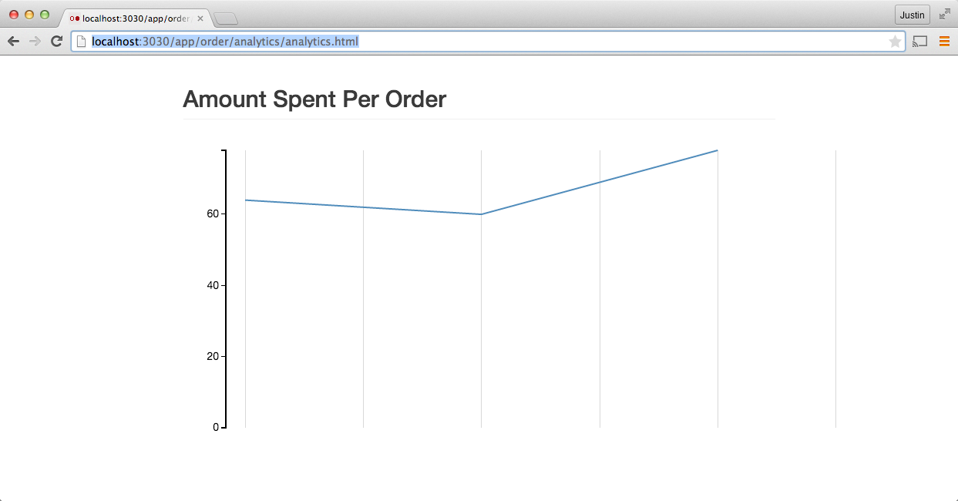
DEMO
http://localhost:3030/app/order/analytics/analytics.html
Notes:
This demo page shows a simple graph of a single restaurant’s orders.
If our designer wanted to add another restaurant, all they would need to do is add another <order-model> and another <bit-series> element.
In our “apps”, we have bit-legends, bit-scales, and other elements that combine to customize a graph.
In this way, they can assemble their data and the graph without a developers help. It’s especially great for prototyping.
Show live-updating

Slide 33
analytics.stache
<can-import from="app/models/order" />
<can-import from="ui/bit_graph/bit_graph"/>
<order-model findAll="{}" [orderdata]="{value}"/>
<bit-graph title="Analytics">
<bit-series data="{../orderdata.totals}" />
</bit-graph>
Notes:
The next thing we support is declaring dependencies in the template. This allows the designer to import new functionality at will.
Even better, it keeps the dependencies local to the place where they are actually being used.
This is also used in progressive loading in the most amazing way possible.

Slide 34
example.jsx
var HelloWorld = React.createClass({
displayName: 'hello-world',
getInitialState: function() {
return {
message: "Hello"
};
},
render: function() {
return <div>{{message}} World!</div>;
}
});
Notes:
Finally, a third thing (even though I said there will be two), I really like how Reacts JSX can keep JavaScript and HTML together. It makes it so you don’t have
to context switch between different files.

Slide 35
webcomponent.html
<template id="sdtemplate">
<style> p { color: orange; } </style>
<p>Hello World</p>
</template>
<script>
var proto = Object.create(HTMLElement.prototype, {
createdCallback: {
value: function() {
var t = document.querySelector('#sdtemplate');
var clone = document.importNode(t.content, true);
this.createShadowRoot().appendChild(clone);
}
}
});
document.registerElement(’hello-world', {prototype: proto});
</script>
Notes:
Webcomponents will offer something very similar.

Slide 36
canjs.js
<can-component tag="hello-world">
<style type="less">
color: red;
</style>
<template> {{message}} World! </template>
<view-model>
export default {
message: "Hello"
};
</view-model>
</can-component>
Notes:
And finally, of course, we have our version.

Slide 37
5. Unit Testable ViewModels
Identify values that represent the state
Write a test for the view model
Write the view model
Write the template
Notes:
- this topic is all about how we approach writing view models
- specifically with an emphasis on writing unit testable view models
- In an MVVM approach, your view models control the flow of a user’s behavior, in a client, that’s tends
to be where most of your complex logic exists.
- So using an example, in the place my order app, we will break down:

Slide 38
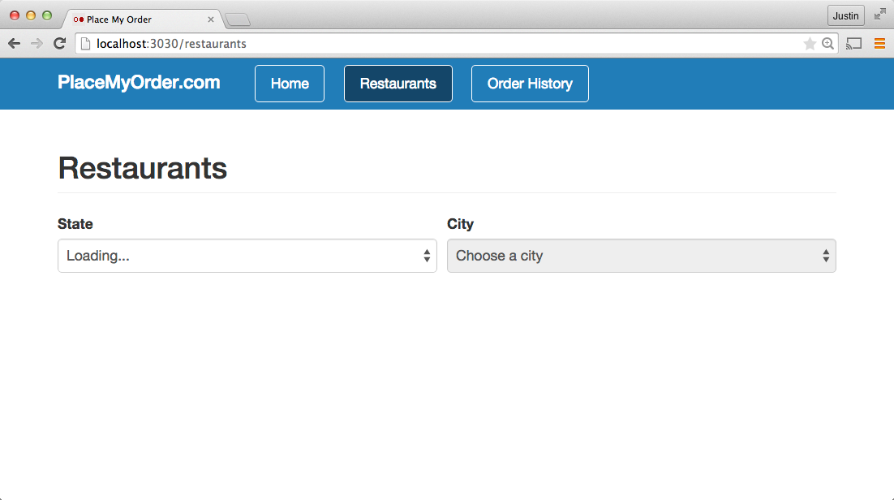

Slide 39
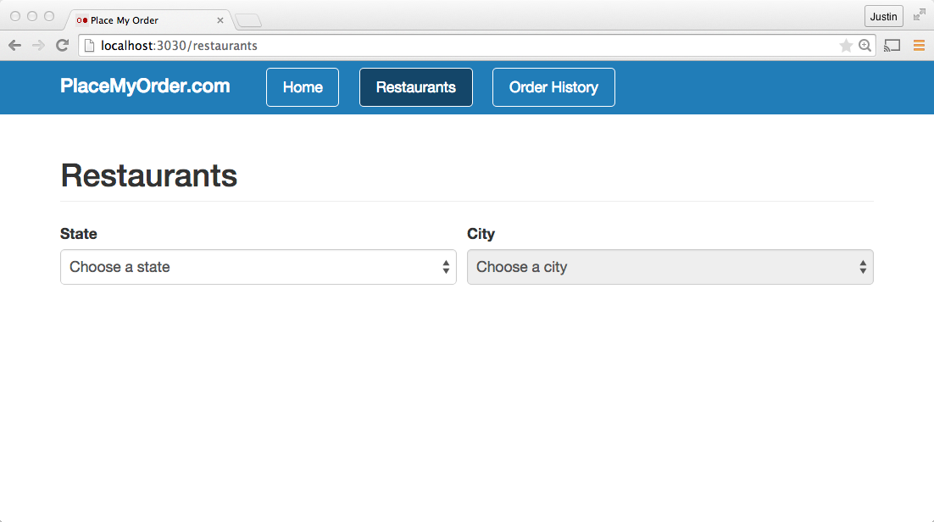

Slide 40
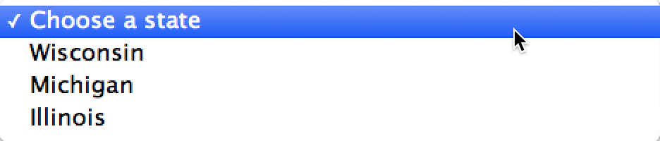

Slide 41
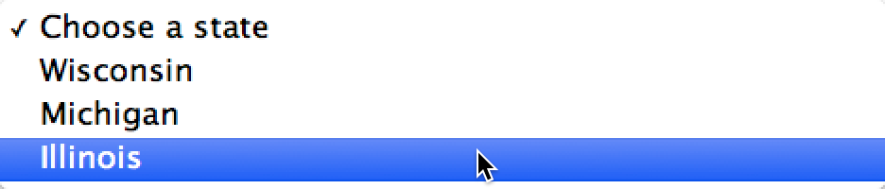

Slide 42
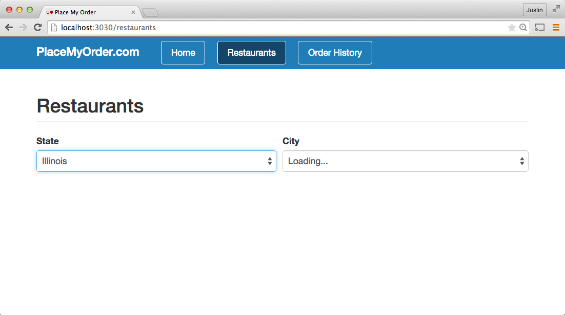

Slide 43


Slide 44
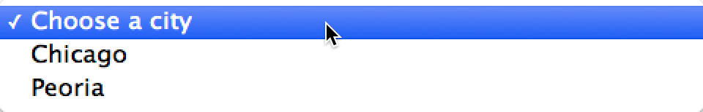

Slide 45
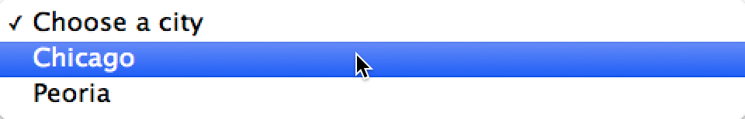

Slide 46
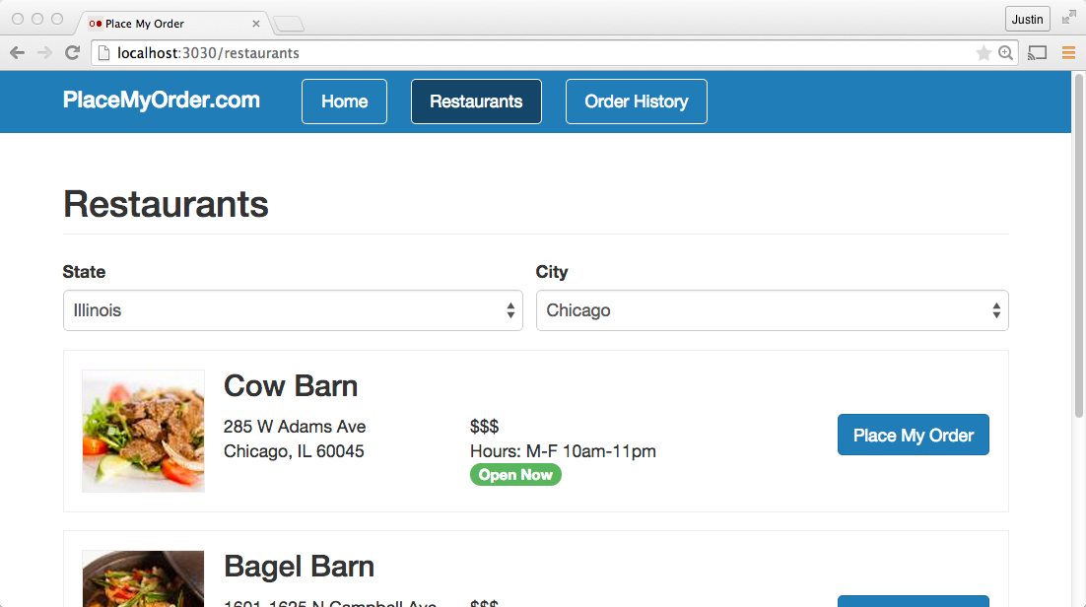

Slide 47


Slide 48


Slide 49
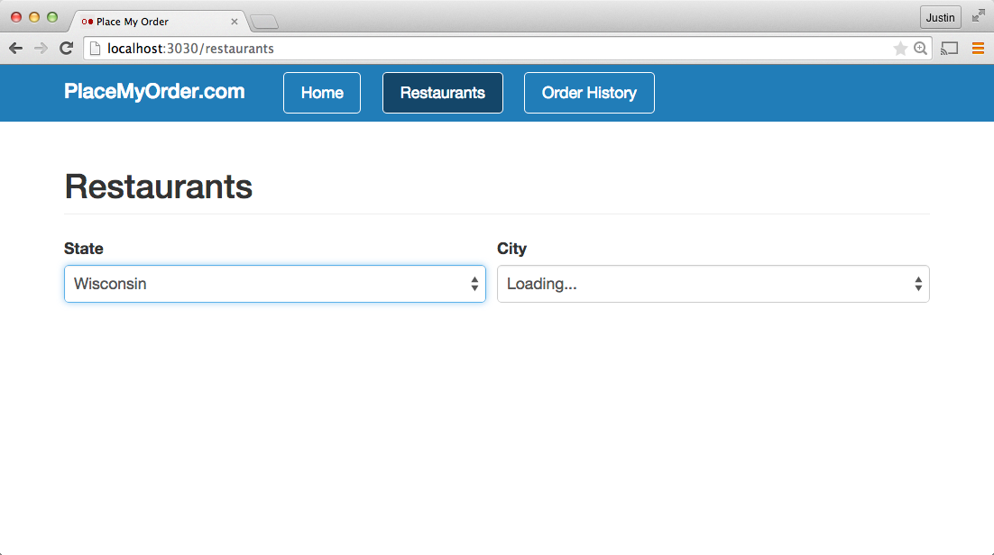

Slide 50
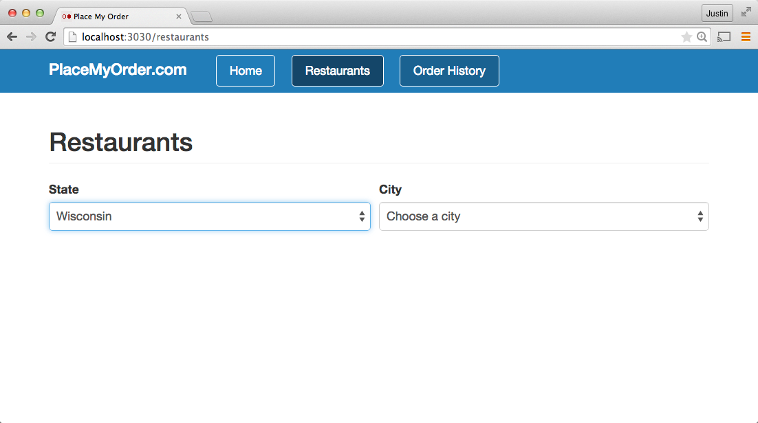

Slide 51
Testable View Models
1. Identify Values That Represent The State

Slide 52
{
states: Promise
}

Slide 53
{
states: Promise
}
<[State]>

Slide 54
{
states: Promise<[State]>
state: String "IL”,
cities: Promise<[City]>,
}

Slide 55
{
states: Promise<[State]>
state: String "IL”,
cities: Promise<[City]>,
city: String "Chicago”,
}

Slide 56
{
states: Promise<[State]>
state: String "IL”,
cities: Promise<[City]>,
city: String "Chicago”,
restaurants: Promise<[Restaurant]>
}

Slide 57
Testable ViewModels
Identify values that represent the state
Test the ViewModel

Slide 58
place_my_order/restaurant/list_test.js
import {ViewModel as RestaurantListVM} from "./list";
import QUnit from 'steal-qunit';
import fixture from 'can/util/fixture/';
QUnit.module("place-my-order/restaurant/list");
QUnit.asyncTest("basics", function(){
…
});

Slide 59
place_my_order/restaurant/list_test.js
QUnit.asyncTest("basics", function(){
var states = [{ name: "Calisota", short: "CA" },
{ name: "New Troy", short: "NT"}];
var caCities = [{state: "CA",name: "Casadina"}];
var ntCities = [{state: "NT", name: "Alberny"}];
var casadinaRestaurants = [{
"_id":"1","name":
"Cheese City","slug":"cheese-city”
}];
…
});

Slide 60
place_my_order/restaurant/list_test.js
QUnit.asyncTest("basics", function(){
…
var casadinaRestaurants = [{ … }];
fixture({
"/api/states": ()=> ({data: states}),
"/api/cities": function(request){
return request.data.state === "CA" ? caCities : ntCities;
},
"/api/restaurants": ()=> ({data: casadinaRestaurants})
})
…
});

Slide 61
place_my_order/restaurant/list_test.js
QUnit.asyncTest("basics", function(){
…
var casadinaRestaurants = [{ … }];
fixture({…})
var rlVM = new RestaurantListVM();
rlVM.attr("states").then(function(vmStates){
QUnit.deepEqual(vmStates.attr(), states, "Got states");
});
});

Slide 62
place_my_order/restaurant/list_test.js
QUnit.asyncTest("basics", function(){
…
rlVM.attr("states").then(function(vmStates){
QUnit.deepEqual(vmStates.attr(), states, "Got states");
rlVM.attr("state","CA");
});
rlVM.one("cities", function( ev, citiesPromise ) {
citiesPromise.then(function( vmCities ) {
deepEqual(vmCities.attr(), caCities, "Got ca cities");
rlVM.attr("city", "Casadina");
});
});
});

Slide 63
place_my_order/restaurant/list_test.js
QUnit.asyncTest("basics", function(){
…
rlVM.one("restaurants", function(ev, restaurantsPromise){
restaurantsPromise.then(function(vmRestaurants){
deepEqual(vmRestaurants.attr(), casadinaRestaurants);
rlVM.attr("state","NT");
ok( !rlVM.attr("city"), "city selection removed" );
rlVM.attr("cities").then(function(vmCities){
deepEqual(vmCities.attr(), ntCities);
start();
});
});
});
});

Slide 64
Testable ViewModels
Identify values that represent the state
Test the ViewModel
Write the ViewModel

Slide 65
place_my_order/restaurant/list.js
import Map from 'can/map/';
export const ViewModel = Map.extend({
define: {
states: {
value() {
return State.findAll({});
}
}
}
});

Slide 66
place_my_order/restaurant/list.js
define: {
states: { … },
state: {
set() {
// Remove the city when the state changes
this.removeAttr('city');
}
},
cities: {
get() {
var state = this.attr('state');
return state ? City.findAll({ state }) : null;
}
}
}

Slide 67
place_my_order/restaurant/list.js
define: {
states: { … },
state: { … },
cities: { … } ,
city: { value: null },
restaurants: {
get: function(){
var state = this.attr('state'),
city = this.attr('city');
return state && city ?
Restaurant.findAll({ state, city }) : null;
}
}
}

Slide 68
Testable ViewModels
Identify values that represent the state
Test the ViewModel
Write the ViewModel
Write the template

Slide 69
place_my_order/restaurant/list.stache
<label>State</label>
<select can-value="{state}" {{#if states.isPending}}disabled{{/if}}>
{{#if states.isPending}}
<option>Loading...</option>
{{else}}
{{^state}}
<option>Choose a state</option>
{{/state}}
{{#each states.value}}
<option value="{{short}}">{{name}}</option>
{{/each}}
{{/if}}
</select>

Slide 70
Benefits
Unit tests without a DOM.
Makes you think about describing the behavior as a set of data changes.

Slide 71
6. Two way routing
Differences from one way routing
Example use
Benefits
Notes:
This topic is about how “two way routing” keeps routing rules out of your application logic, resulting in
code that doesn’t need to change if routing rules do.
I’ll talk about the difference between one way and two way routing. Show how it changes your code, and then detail some of the benefits.

Slide 72
/restaurants/cheese-city
route(':page');
route(':page/:slug');
route(':page/:slug/:action');
{
page: 'restaurants',
slug: 'cheese-city'
}

Slide 73
/restaurants/cheese-city/order
route(':page');
route(':page/:slug');
route(':page/:slug/:action');
{
page: 'restaurants',
slug: 'cheese-city',
action: 'order'
}

Slide 74
{
page: 'order-history'
}
route(':page');
route(':page/:slug');
route(':page/:slug/:action');
/order-history

Slide 75
{
page: 'restaurants',
slug: 'burger-bar',
action: 'confirm'
}
route(':page');
route(':page/:slug');
route(':page/:slug/:action');
/restaurants/burger-bar/confirm

Slide 76
{
page: 'restaurants',
state: 'IL',
city: 'Chicago'
}
route(':page');
route(':page/:slug');
route(':page/:slug/:action');
/restaurants?state=IL&city=Chicago

Slide 77
main.stache
{{#routeMatches "/home"}}
<app-home></app-home>
{{/}}
{{#routeMatches "/restaurants"}}
<app-restaurant-list></app-restaurant-list>
{{/}}

Slide 78
main.stache
{{#eq route.page "home"}}
<app-home></app-home>
{{/eq}}
{{#eq route.page "restaurants"}}
<app-restaurant-list></app-restaurant-list>
{{/eq}}

Slide 79
place_my_order/restaurant/list.stache
{{#each restaurants.value}}
<div class="restaurant">
<h3>{{name}}</h3>
<a href="/restaurants/{{slug}}">
Place My Order
</a>
</div>
{{/each}}
href="/restaurants/cheese-city"

Slide 80
place_my_order/restaurant/list.stache
{{#each restaurants.value}}
<div class="restaurant">
<h3>{{name}}</h3>
<a can-href="{ page='restaurants' slug=slug }">
Place My Order
</a>
</div>
{{/each}}
href="/restaurants/cheese-city"

Slide 81
place_my_order/routes.js
route(':page');
route(':page/:slug');
route(':page/:slug/:action');

Slide 82
place_my_order/routes.js
route(':page');
route(':page/restaurant/:slug');
route(':page/restaurant/:slug/:action');

Slide 83
place_my_order/restaurant/list.stache
{{#each restaurants.value}}
<div class="restaurant">
<h3>{{name}}</h3>
<a can-href="{ page='restaurants' slug=slug }">
Place My Order
</a>
</div>
{{/each}}
href="/restaurants/restaurant/cheese-city"

Slide 84
Benefits
Keep routing rules separate from application logic.
Update routing rules independent of the page.
Makes you think about describing the route’s stateful properties.

Slide 85


7. Super Models
Notes:
This topic is how I think we’ve solved a huge SET of challenges with client side model layers.
Your application’s Model, the layer that connects the client to your backend services, is one of the performance sensitive pieces of your application.
We’ve made it easy to get high performance models and add real-time behaviors.
It’s responsible for controlling network behavior.
It can also be one of the more complex parts of your app.

Slide 86
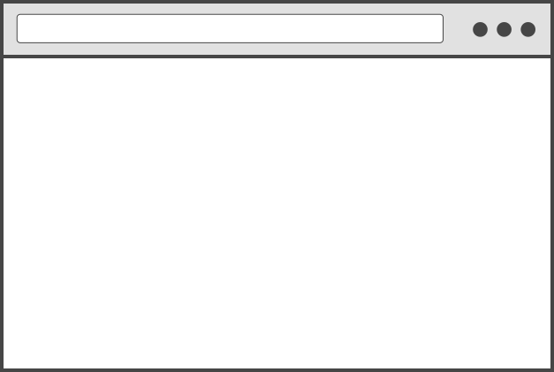

The Problem
<todos-complete>
<todos-incomplete>
Notes:
This logic can be tricky. Consider if we have two widgets showing completed, todos and incomplete todos. How
do we make them make a single request? When a server-side update happens, how do we a todo go from one list to the other list?
How do we save the data in localstorage so it doesn’t have to be retrieved again?
The answer to this is suprisingly simple: SETS.

Slide 87
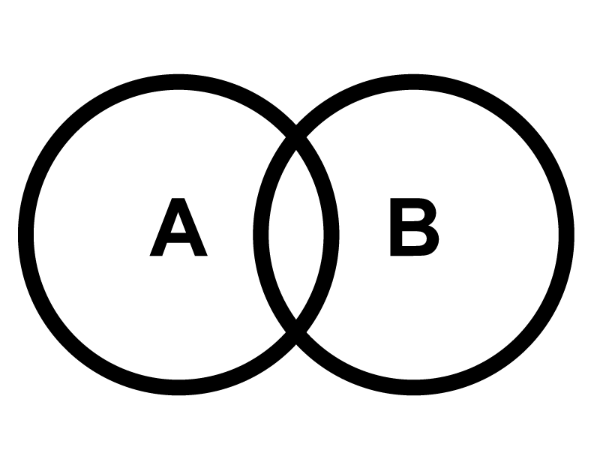
A = B | Equal
A ⊆ B | Subset
A ⊂ B | Proper Subset
A \ B | Difference
A ∩ B | Intersection
A ∪ B | Union
Notes:
… set algebra!
Yes, sets as in venn diagrams.
Why sets?

Slide 88
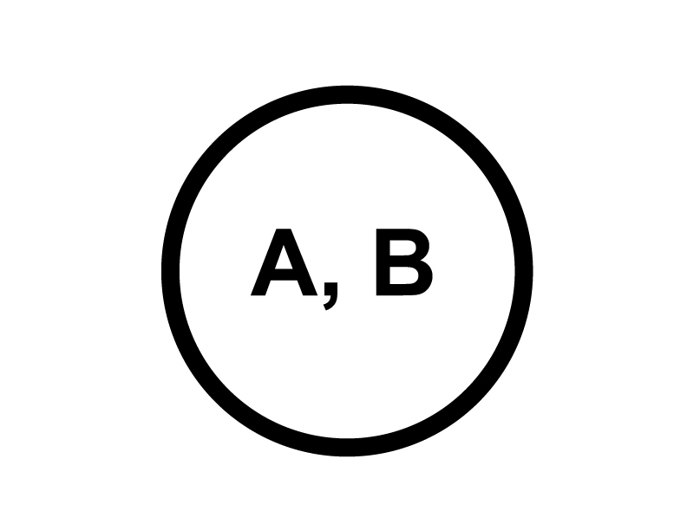
A = B | Equal
A ⊆ B | Subset
A ⊂ B | Proper Subset
A \ B | Difference
A ∩ B | Intersection
A ∪ B | Union
Notes:
… set algebra!
Yes, sets as in venn diagrams.
Why sets?

Slide 89

A = B | Equal
A ⊆ B | Subset
A ⊂ B | Proper Subset
A \ B | Difference
A ∩ B | Intersection
A ∪ B | Union
or
Notes:
… set algebra!
Yes, sets as in venn diagrams.
Why sets?

Slide 90
A = B | Equal
A ⊆ B | Subset
B ⊂ A | Proper Subset
A \ B | Difference
A ∩ B | Intersection
A ∪ B | Union
Notes:
… set algebra!
Yes, sets as in venn diagrams.
Why sets?

Slide 91
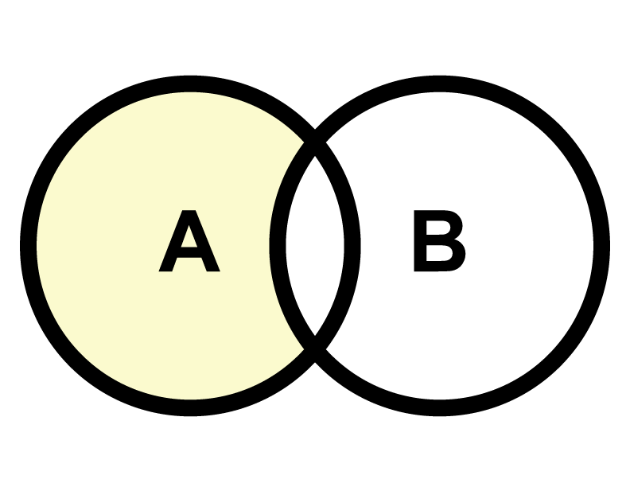
A = B | Equal
A ⊆ B | Subset
A ⊂ B | Proper Subset
A \ B | Difference
A ∩ B | Intersection
A ∪ B | Union
Notes:
… set algebra!
Yes, sets as in venn diagrams.
Why sets?

Slide 92
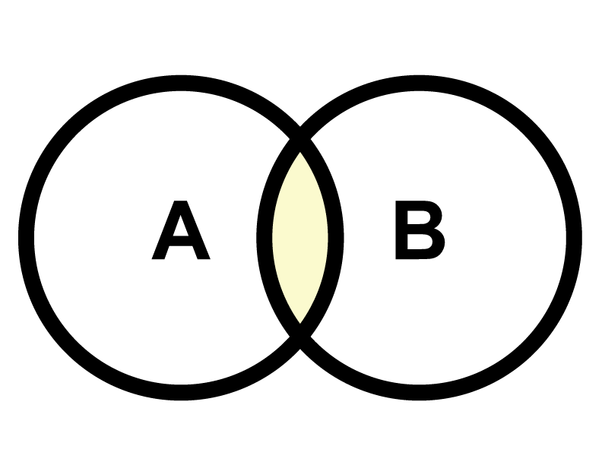
A = B | Equal
A ⊆ B | Subset
A ⊂ B | Proper Subset
A \ B | Difference
A ∩ B | Intersection
A ∪ B | Union
Notes:
… set algebra!
Yes, sets as in venn diagrams.
Why sets?

Slide 93
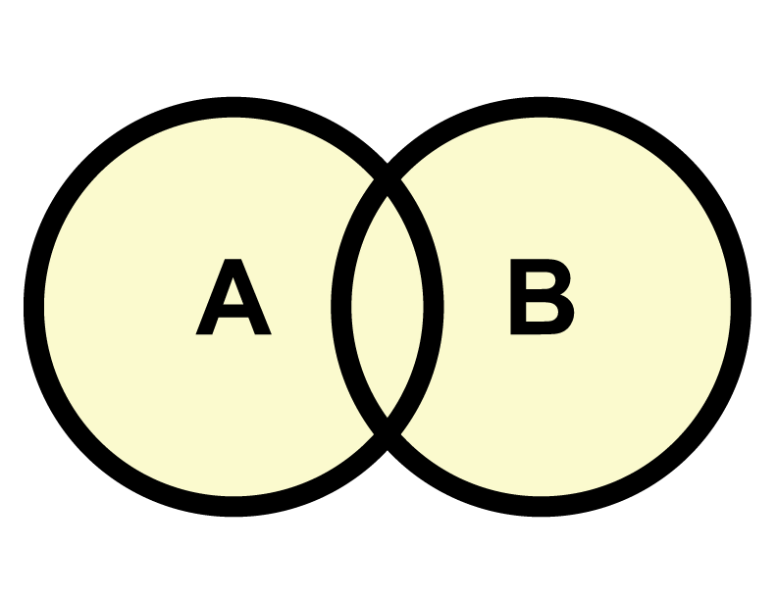
A = B | Equal
A ⊆ B | Subset
A ⊂ B | Proper Subset
A \ B | Difference
A ∩ B | Intersection
A ∪ B | Union
Notes:
… set algebra!
Yes, sets as in venn diagrams.
Why sets?

Slide 94
var setA = {
userId: 5,
completed: true
};
$.get("/api/todos", setA, function(todos){ ... })
//-> api/todos?userId=5&completed=true
Notes:
It’s because the params you pass to get data from a server always represent that “set” of data.
setA represents all todos that belong to user 5 that are completed.
By associating a set with the data you load, you are able to achieve all sorts of awesome performance techniques.

Slide 95
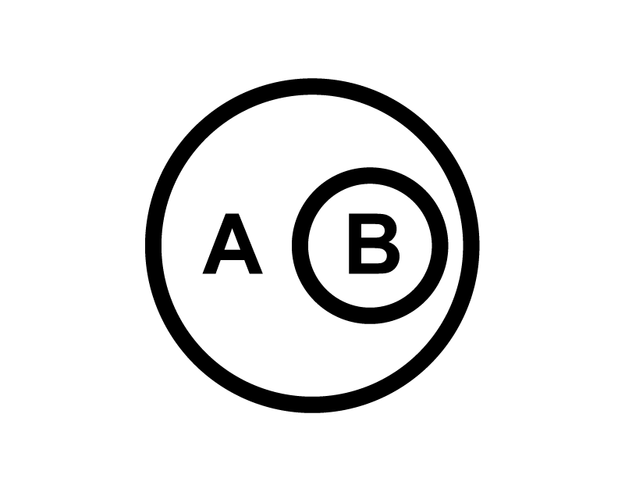
var setA = {
userId: 5,
completed: false
};
var setB = {
userId: 5,
completed: false,
type: 'critical'
};
// B ⊆ A
set.subset(
setB,
setA ) //-> true
Notes:
For example, I could compare setA to another set, setB.
setB might represent all todos for user5 that are completed AND critical.
setB is a subset of setA. All the items that are completed and critical are also critical.
With this information, you could, for example use the data returned by setA to populate the
data needed by setB, saving a request.
To help with this, we made a set library that performs set algebra using plain JavaScript objects
that look like the params you normally send to the server.
Lets see other optimizations you can do with set algebra.

Slide 96
var algebra = new set.Algebra(
set.comparators.rangeInclusive("start", "end"),
set.comparators.enum("status", ["new","delivered"]),
set.comparators.boolean("completed")
);
algebra.subset(
{start: 0, end: 50},
{start: 0, end: 100}
); //-> true
Notes:
But first, our set library lets you create algebras that work with things like binary and enumerated properties, and ranges. And it’s pretty easy to create your own special comparators.

Slide 97

todos.com
{complete: true}
{complete: false}
algebra.union(
{complete: true},
{complete: false}
) //-> {}
Notes:
Combine Requests
With that, you can do techniques like combine simultaneous requests into a single request.
requests without thinking!

Slide 98
todos.com/complete
todos.com/all
{complete: true}
{}
algebra.difference(
{},
{complete: true}
) //-> {complete: false}
Notes:
Or load what you haven’t loaded already.
requests without thinking!

Slide 99
newTodo
{complete: false, id: 5, name: "do dishes"}
set.subset(
newTodo, incomplete ) //-> true
complete
incomplete
{complete: true}
{complete: false}
todos.com
Notes:
Or figure out set an item belongs to.
This is amazing for real time connections.
have a box showing “model logic”
requests without thinking!

Slide 100
Sets give you:
Automatic live updates
Speed
inline-cache
combine requests
fall through caching

Slide 101
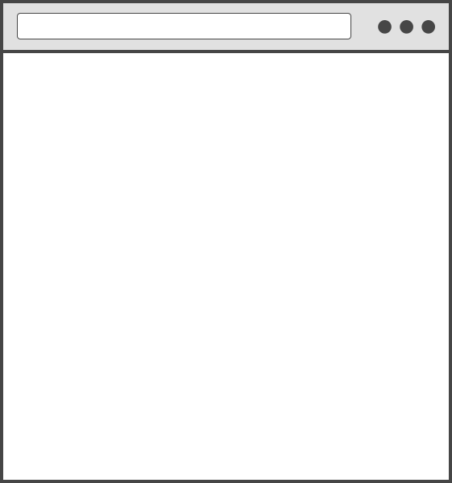
Inline Cache
GET /order-history
New
Preparing
<html>
...
<script>
INLINE_CACHE= {
"orders": {
"{status: ‘new’}": [ ... ],
"{status: ‘preparing’}": [ ... ],
…
}
}
</script>
</html>
Delivery
Delivered

Slide 102

/order-history
GET /order-history
New
Preparing
<html> INLINE_CACHE={} </html>
Delivery
Delivered
4
4
4
findAll="{status='new'}”
findAll="{status=’preparing'}”
findAll="{status=’delivery'}”
findAll="{status=’delivered'}”
4
4
4
orders/sets/{}

Slide 103
Fall Through
/order-history
New
Preparing
Delivery
Delivered
1
1
4
4
4
1
findAll="{status='new'}”
findAll="{status=’preparing'}”
findAll="{status=’delivery'}”
findAll="{status=’delivered'}
4
1
4
1
orders/sets/{}

Slide 104
Real Time
/order-history
New
Preparing
Delivery
1
Delivered
findAll="{status='new'}”
findAll="{status=’preparing'}”
findAll="{status=’delivery'}”
findAll="{status=’delivered'}"
1
orders/sets/{}
Notes:
lists are registered by listening to them.
can optimize to know which sets the instance was likely in before removing removing.
however, the number of lists is rarely big.
also, have a keyed lookup
localstorage is updated even when you aren’t on the page!

Slide 105
8. Live Reload
Demo
Benefits
How it works
Notes:
how it works (only get the changed module, re-execute only that module and its parents)
performance differ

Slide 106
Demo
Notes:
public justin$ npm run live-reload

Slide 107
Benefits
0.1 second – users feel like their actions are directly causing something to happen on the screen.
1 second - users notice the short delay, but they stay focused on their current train of thought.
http://www.nngroup.com/articles/powers-of-10-time-scales-in-ux/

Slide 108

/order-history
history.js
</>
history.stache
order.js
history.less
</>
</>
history.less
</>
</>
can.js
</>
jquery.js
</>
Notes:
Performance
Packages
Show how app.js specifies which parts of the SPA should contain packages
Show /packages folder with all the packages. Show demo of loading a new package.
Show how some package files are combined from different sections of the app (cart-home-product.js contains stuff for the cart, homepage, and product page).
Explain how this optimizes performance (especially for the homepage)
Show how crawlified pages are always serving the index-ed HTML, then JS run on top of that, which optimizes perceived performance
I would show a few Product pages and Category pages for this.
SPA optimized for speedy page loads
production mode loads single CSS, JS
navigating the app is much faster than current site because its a SPA, no page load

Slide 109
/order-history
history.js
history.js
</>
</>
New
order.js
history.stache
order.js
history.less
Preparing
history.stache
</>
history.less
</>
</>
</>
</>
</>
Delivery
Delivered
can.js
can.js
</>
</>
jquery.js
jquery.js
</>
</>
Notes:
Performance
Packages
Show how app.js specifies which parts of the SPA should contain packages
Show /packages folder with all the packages. Show demo of loading a new package.
Show how some package files are combined from different sections of the app (cart-home-product.js contains stuff for the cart, homepage, and product page).
Explain how this optimizes performance (especially for the homepage)
Show how crawlified pages are always serving the index-ed HTML, then JS run on top of that, which optimizes perceived performance
I would show a few Product pages and Category pages for this.
SPA optimized for speedy page loads
production mode loads single CSS, JS
navigating the app is much faster than current site because its a SPA, no page load

Slide 110
/order-history
history.js
history.js
</>
</>
New
New
order.js
history.stache
order.js
history.less
Preparing
history.stache
history.less
Preparing
</>
</>
</>
</>
</>
</>
Delivery
Delivery
Delivered
Delivered
can.js
can.js
</>
</>
jquery.js
jquery.js
</>
</>
Notes:
Performance
Packages
Show how app.js specifies which parts of the SPA should contain packages
Show /packages folder with all the packages. Show demo of loading a new package.
Show how some package files are combined from different sections of the app (cart-home-product.js contains stuff for the cart, homepage, and product page).
Explain how this optimizes performance (especially for the homepage)
Show how crawlified pages are always serving the index-ed HTML, then JS run on top of that, which optimizes perceived performance
I would show a few Product pages and Category pages for this.
SPA optimized for speedy page loads
production mode loads single CSS, JS
navigating the app is much faster than current site because its a SPA, no page load

Slide 111
9. Smart Progressive Loading
Difficulties loading apps
The smart bundling algorithm
Declaring bundle mains … in templates
Demo (if there’s time)
Notes:
algorithim

Slide 112
Switch to Keynote

Slide 113
main.stache
{{#eq route.page "home"}}
<can-import from="app/home/home">
{{#isResolved}}
<app-home></app-home>
{{/isResolved}}
</can-import>
{{/eq}}
{{#eq route.page "restaurants"}}
{{^slug}}
<can-import from="app/restaurant/list/list">
{{#isResolved}}
<app-restaurant-list></app-restaurant-list>
{{/isResolved}}
</can-import>
{{else}}
Notes:
Run grunt build to build the app.
Switch to production: export NODE_ENV=production.
npm start.
Open dev tools again and show the same navigation and the bundles getting loaded, shared dependencies, etc.

Slide 114
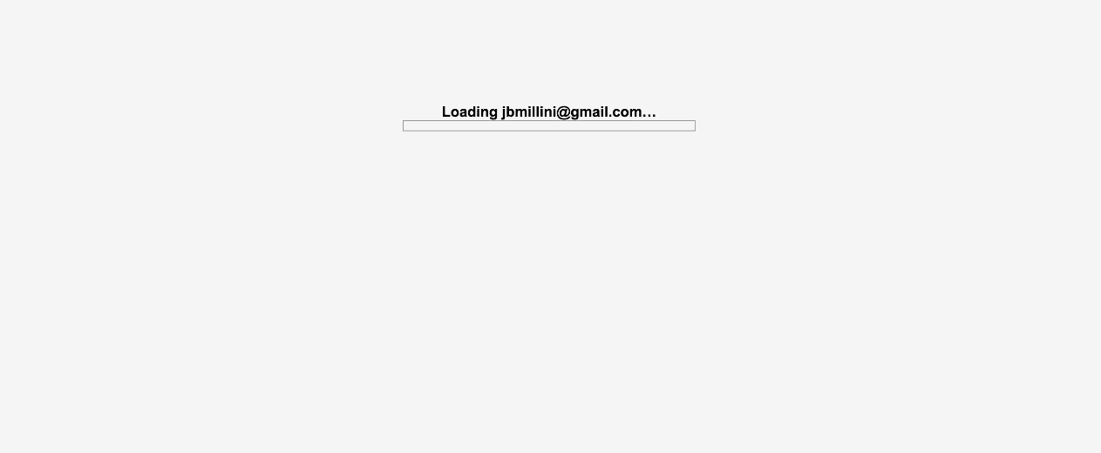
10. Server Side Rendering
Notes:
- this is not server side rendered
- this is

Slide 115
Demo
Notes:
s

Slide 116
Benefits
SEO
Perceived Performance

Slide 117
Single Context Virtual DOM
Everything runs in a single node context.
Using a very lightweight DOM.
Everything connected to render lifecycle
Notes:
The technique we are using is a single node context virtual DOM.

Slide 118
main.stache
{{#eq route.page "home"}}
<can-import from="app/home/home">
{{#isResolved}}
<app-home></app-home>
{{/isResolved}}
</can-import>
{{/eq}}
{{#eq route.page "restaurants"}}
{{^slug}}
<can-import from="app/restaurant/list/list">
{{#isResolved}}
<app-restaurant-list></app-restaurant-list>
{{/isResolved}}
</can-import>
{{else}}
Notes:
Run grunt build to build the app.
Switch to production: export NODE_ENV=production.
npm start.
Open dev tools again and show the same navigation and the bundles getting loaded, shared dependencies, etc.

Slide 119
lib/app.js
steal.import("app/main.stache!can/view/autorender/system",
"app/layout.stache!").then(function([ main, layout ]){
express().use("/", function(req, res){
var pathname = url.parse(req.url).pathname;
main.renderNode(pathname).then(function(renderData){
var html = layout.render({
content: renderData.html,
inlineCache: renderData.data
});
res.send(html);
});
});

Slide 120
layout/main.stache
<html>
<head>
<title>Place My Order</title>
</head>
<body>
{{{content}}}
<script {{inlineCache}}></script>
{{#if isProd}}
<script src="/node_modules/steal/steal.production.js"></script>
{{else}}
<script src="/node_modules/steal/steal.js"></script>
{{/if}}
</body>
</html>

Slide 121
place-my-order/restaurant/list.js
export const ViewModel = Map.extend({
states: { get() { return State.findAll({}); } }, …
});
export default Component.extend({
tag: 'app-restaurant-list',
viewModel: ViewModel,
template,
events: {
inserted: function(){
var statesPromise = this.attr("states");
this.scope.attr("@root").pageData( statesPromise );
}
}
});

Slide 122
Techniques
Duplicate Code
+0 Maintainability +10 Speed
Headless Browser
+9 Maintainability +5 Speed
Single Context Virtual DOM
+8 Maintainability +8 Speed
Notes:
Caching throws all of this out the window

Slide 123

Thanks - @bitovi

